Slide 1
Revered and Rich Temples of India
Presented by - Appa on 15 April 2016

Slide 2
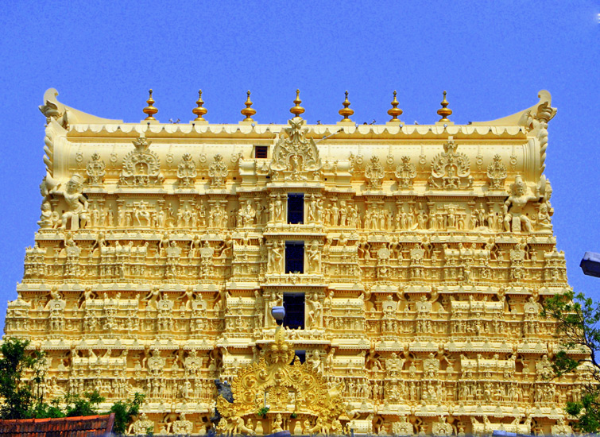
Padmanabhaswamy Temple, Kerala.
Location: W Nada, East Fort, in Thiruvananthapuram, Kerala
The richest temple in the country, the shrine of Lord Padmanabhaswamy possesses wealth of around $20 billion in six vaults of Gold. The Golden idol of Mahavishnu, found in this temple worth Rs. 500 Crore.
The Gold necklace adding charm to the divinity of the deity is 18 ft long and weighs around 2.5kg.
With recent discovery of “nelamalia” (underground room) more than 1lack crore worth its became richest temple in India.

Slide 3
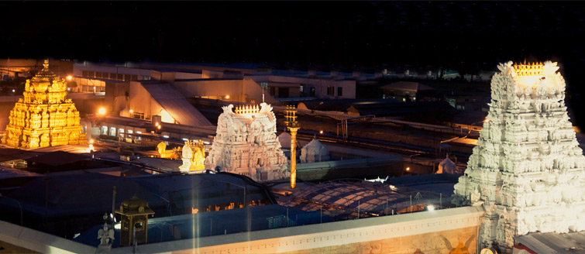
Tirumala Tirupati Venkateswara Temple, Andhra Pradesh
Location: S Mada Street, Tirumala, Tirupati, Andhra Pradesh
May be till last decade, Tirupati temple was believed to be the richest temple in the country. But after the reports disclosing the unbelievable amount of assets possessed by Padmanabhaswamy Temple, Tirupati has gone down to the second position in terms of possessing wealth
Everyday around 60,000 devotees
The presiding deity of the temple, Lord Venkateswara is clad with 1000kgs of Gold.
The annual income out of selling laddus is around 11million dollars.
It is estimated that the temple gets donation of around 650 crore every year.

Slide 4
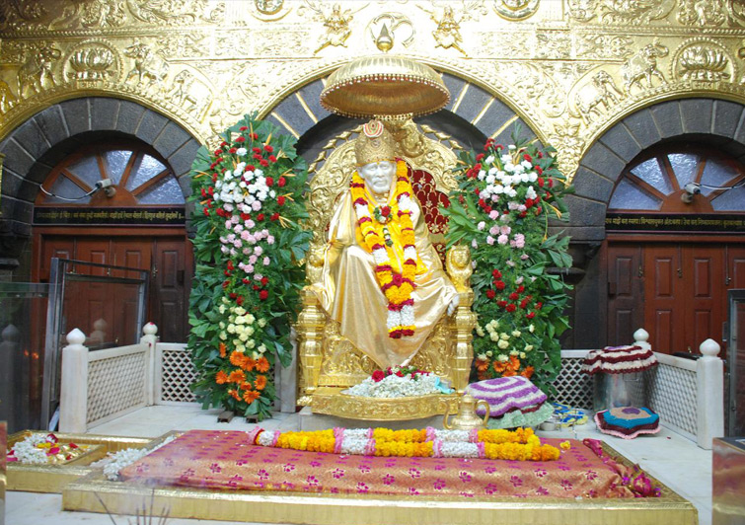
Shirdi Saibaba
Location: Shirdi in Rahata Taluka of Ahmednagar District, Maharashtra
Visited by the people of all religions this divine travel destination.
Gold and silver jewellery worth approximately Rs 32 crore and silver coins worth more than Rs 6 lakh.
The annual donation received by the temple reaches up to an amount of around 360crore.

Slide 5
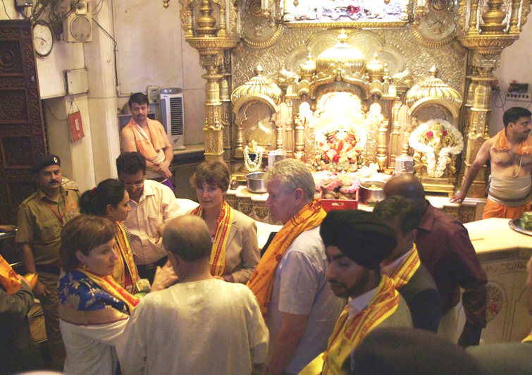
Vaishno Devi Temple, Jammu
Location: Katra, Jammu and Kashmir
One of the oldest and richest temples in India.
The shrine of Mata Vaishno Devi is visited by millions of devotees from across the world.
Centre of deep rooted religious beliefs of the Hindus.
The temple has an annual income of around 500 crore.
Every year around 8 million pilgrims visit this temple and it is claimed to be the second most visited temple in India after Tirupati.

Slide 6
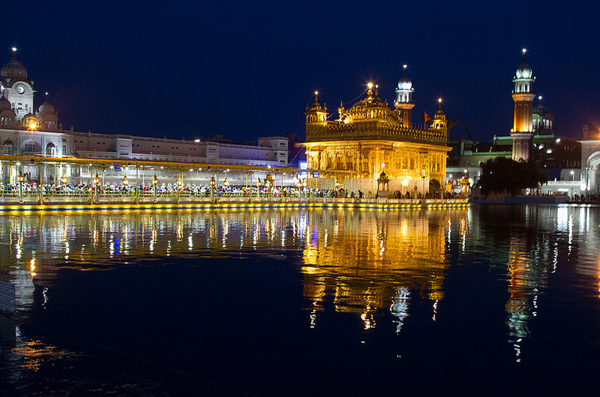
Golden Temple, Amritsar
Location: Amritsar, Punjab
The most famous religious centre of the Sikh Community
The canopy of the temple is made of gold. The altar on which the holy book Guru Granth Sahib is kept is studded with precious diamonds and bright stones.
It is estimated that on an average around 40,000 visitors throng here in Golden Temple every day.

Slide 7
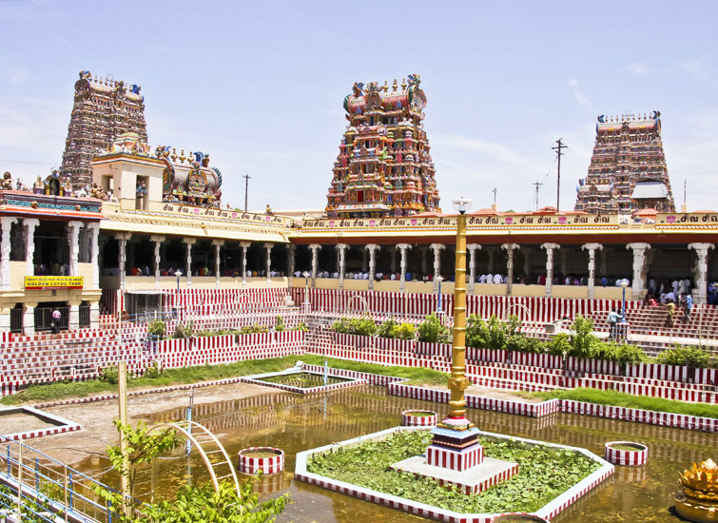
Meenakshi Temple, Madurai
Location: Madurai, Tamil Nadu
One of the few temples in India that receives 20-30k people every day.
Meenakshi Temple earns revenue of around 60million every year.

Slide 8
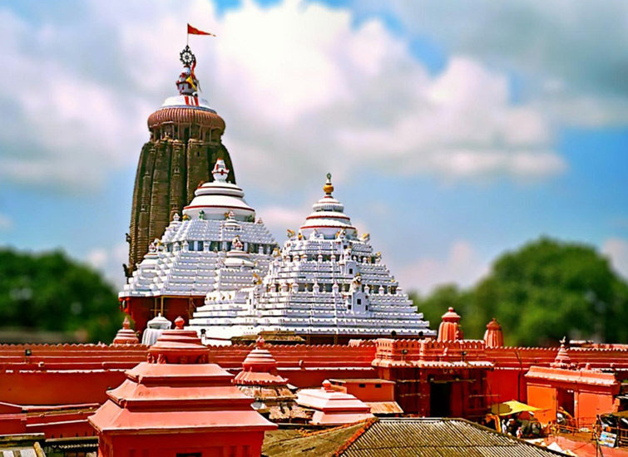
Jagannath Temple, Puri
Location: Grand Road, Puri, Odisha
According to a report published in 2010, the bank deposits of Lord Jagannath Temple was about to reach 150 crore.
The temple receives donation of around Rs. 15,000 to 20,000 with six times more donations in festive season.
More than 30,000 devotees throng the shrine everyday and around 70,000 per day in festive season.
A European devotee once donated 1.72 crore rupees through State Bank of India.

Slide 9
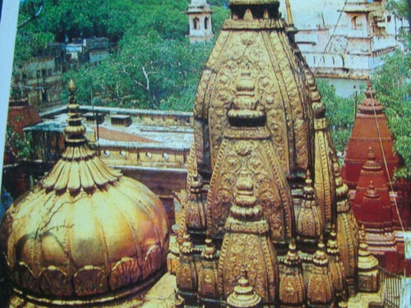
Kashi Vishwanath Temple, Varanasi
Location: Varanasi, Uttar Pradesh
One of the most celebrated religious travel destinations in the country,
Kashi Vishwanath Temple still stands in glory despite being looted and demolished several times in past.
It is estimated that around over 3 million domestic and 200,000 foreign tourists visit this temple annually.
The annual donations to Kashi Vishwanath come to a figure of around Rs 4-5 crore. Out of the three domes of the temple, two domes are gold plated.

Slide 10
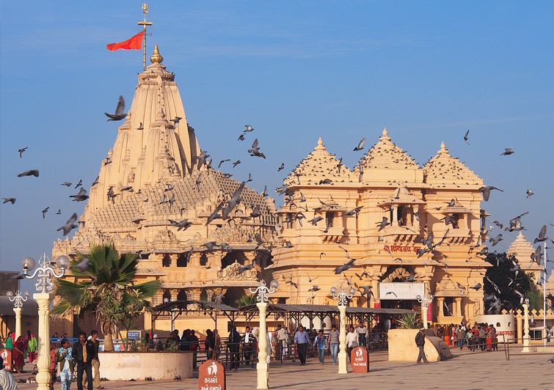
Somnath Temple, Gujarat
Location: Prabhas Kshetra near Veraval in Saurashtra, Gujarat
A temple which had been looted and demolished by the invaders around 17 times for its brimming gold and silver repository,
Somnath Temple still possesses enough of assets to be called one of the richest temples in India.
Exclusive architectural design, immense religious significance and overall the involvement of advanced scientific method to the construction of this coastal temple make this religious site a traveller’s delight.

